Slide 1

COE Preview
Department of Educational Psychology & Learning Systems Information Session
education.fsu.edu

Slide 2
EPLS Presentation Schedule

Slide 3
EPLS: Degrees & Majors
Counseling & Human Systems
Career Counseling
(M.S./Ed.S.)
Mental Health Counseling
(M.S./Ed.S.)
Counseling Psychology & Human Systems
Educational Psychology
Counseling Psychology & School Psychology (Combined Ph.D. Program)
School Counseling
(M.S./Ed.S.)
School Psychology
(M.S./Ed.S.)
Learning & Cognition
(M.S. and Ph.D.)
Sport Psychology
(M.S. and Ph.D.)
Measurement & Statistics
(M.S. and Ph.D.)
Instructional Systems &
Learning Technologies
Learning Design &
Performance Technology (Ed.D.)
Instructional Systems &
Learning Technologies
(M.S. and Ph.D.)
Department of Educational Psychology & Learning Systems

Slide 4
The PURPOSE program seeks to train a diverse cohort of students in research with a focus on social justice in education. The goal of the program is to provide students with opportunities to develop the knowledge and skills needed to enter and successfully complete graduate programs in education and related fields.
PURPOSE fellows:
Spend one year developing research skills through varied experiences (Jan-Dec)
Develop one-on-one faculty mentorships
Attend bi-weekly proseminars
Conduct research & service with children aged 5-14 in a service-learning research practicum
Earn a total annual stipend of $11,000
Receive up to $2,000 for research materials, travel, and other costs, such as GRE and graduate application fees
Apply in fall 2023
For more information visit: www.purposetraining.org

Slide 5
Certificate in College Teaching
Certificate Coordinator: Dr. Alysia Roehrig (aroehrig@fsu.edu)
The graduate certificate in College Teaching will give you the knowledge and skills needed to be an effective teacher at the college and university level. The certificate courses will prepare you in essential areas of postsecondary teaching, including educational frameworks, instructional strategies, assessment approaches, learning theories, and classroom management. By the end of the program, you’ll be able to design college courses, develop assessments, and use theory and research to address educational issues.
Any individual who 1) has an undergraduate degree and 2) is eligible to enroll as a non-degree seeking student, or who qualifies for graduate admission to the university, is eligible to apply for admission to the certificate in College Teaching.

Slide 6
Certificate in College Teaching
The following are required courses (total of 12 credit hours):
  EDP 5216 Theories of Learning and Cognition
  EDH 5305 College Teaching: Instruction in Higher Education
  EDF 5431 Classroom Assessment
  EDF 6755 Theoretical and Practical Issues in Education
The certificate requires 12 graduate credits to be earned within a seven-year period. Transfer credits are not accepted. A minimum of 3.25 grade point average is required and no course grade lower than a B will count toward the certificate.
  Up to 12 hours of this certificate may be counted toward a graduate degree in Educational Psychology: Learning and Cognition.

Slide 7
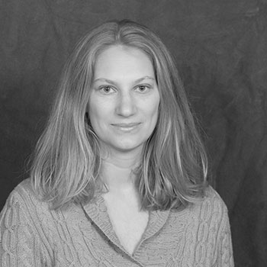
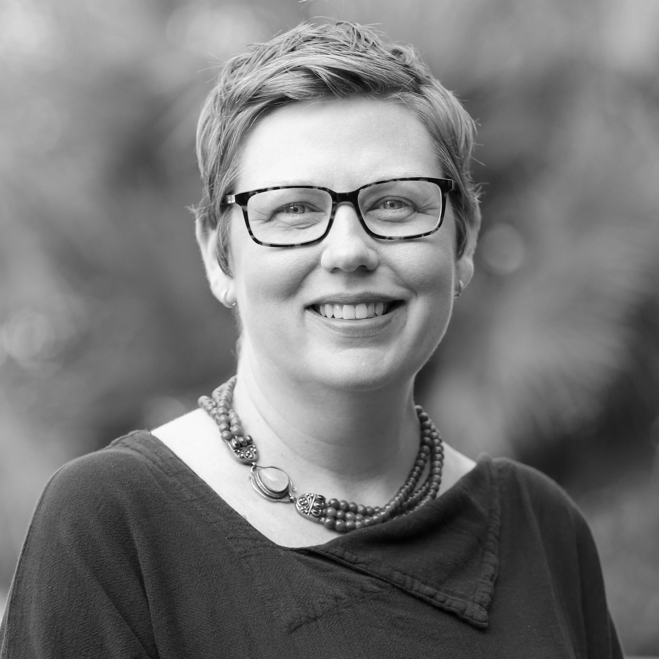
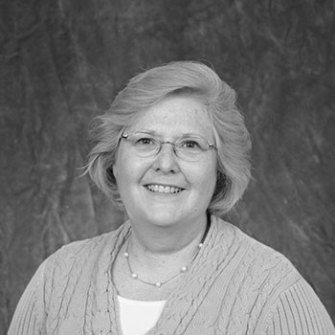
Educational Psychology: Learning & Cognition (MS, PhD)
Dr. Beth Phillips Dr. Alysia Roehrig Dr. Jeannine Turner
Faculty Faculty/Program Coordinator Faculty
bmphillips@fsu.edu aroehrig@fsu.edu jeturner@fsu.edu

Slide 8
Educational Psychology: Learning & Cognition (MS, PhD)
education.fsu.edu/learning-cognition
Ranked as a top 25 Educational Psychology degree program nationally, our Learning and Cognition program offers students and professionals an advanced understanding of cognition, learning, and developmental theories.
Our students come from many backgrounds to apply Learning and Cognition in research, classroom, government, or organizational settings.

Slide 9
Educational Psychology: Learning & Cognition (MS)
The master’s program consists of 30-35 credit hours minimum, depending on the track. Students develop their program of study in conjunction with their advisor and follow one of two tracks: Thesis-track or Coursework-track.
  The Thesis-track is geared toward students who want more practical research training or would like to pursue a PhD. The Thesis-track MS is a residential program that takes approximately 3 years to complete.
  The Coursework-track MS takes less than 2 years to complete and may be completed entirely online. Students with this degree are able to take on more advanced positions or hone their craft in their current field of work.

Slide 10
Educational Psychology: Learning & Cognition (PhD)
Our doctoral program is designed to train research-oriented doctoral students who are conversant with current theory and research, and who are competent in methodological and statistical research skills. Students who complete their doctorates in our program become university faculty or researchers in a variety of settings, including with Pre-K-12 education organizations, government, think tanks, and private industry.
The PhD program consists of 42 course credit hours and 24 dissertation hours. Students develop their program of study in conjunction with their advisor. It takes approximately 3-4 years for fulltime students to complete the degree.

Slide 11
Educational Psychology: Learning & Cognition
Application to the MS requires a bachelor’s degree with at least a 3.0 GPA
Application to the PhD requires a master’s degree with at least a 3.3 GPA
GRE only required for PhD. Target Scores:
  Verbal – 50th
  Quantitative – 20th percentile
  Analytical/writing – 3.5
  After 2021 the GRE may be waived for MS applicants who have related experience
Thesis-MS and PhD students are eligible for assistantships
  Each summer, faculty determine the available positions and fit of students who intend to enroll

Slide 12
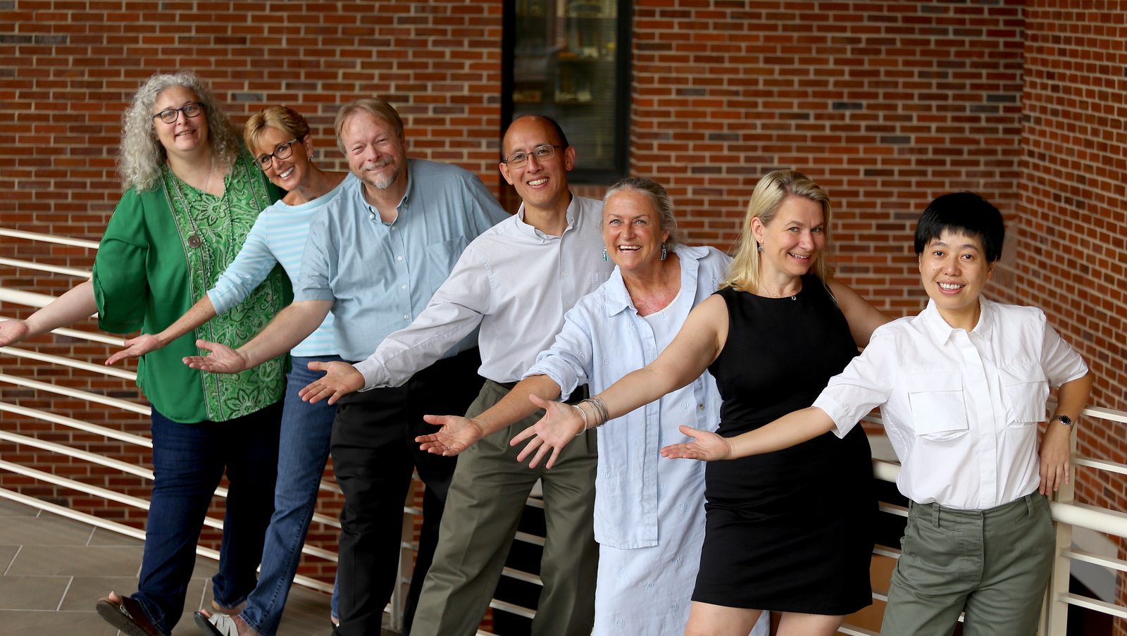
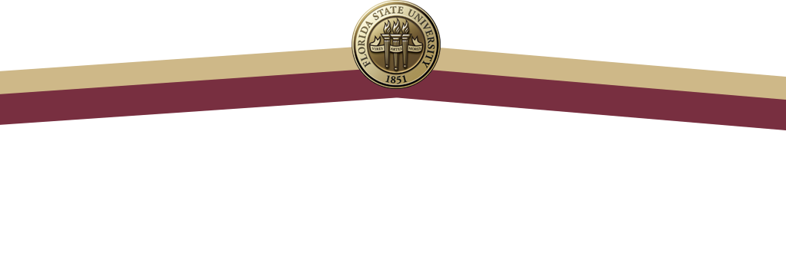
MS in Instructional Systems & Learning Technologies
EdD in Learning Design & Performance Technologies
PhD in Instructional Systems & Learning Technologies
Graduate Certificates
Human Performance Technology
Instructional Design & Technology
Online Teaching & Learning
Instructional Systems &
Learning Technologies

Slide 13
ISLT Admissions Requirements
REQUIREMENT | Certificate | MS | EdD | PhD
Bachelor’s Degree | X | 3.0 GPA in last 2 years | 3.2 GPA in last 2 years | 3.2 GPA in last 2 years
Master’s Degree |  |  | Required | Preferred
GRE* |  | [currently waived] | 50th Percentile on Verbal Analytical Writing 3.5+ | 50th Percentile on Verbal and Quantitative Analytical Writing 4+
Personal Statement |  | X | X | X
Recommendations |  | 3 | 3 | 3
Resume / CV |  | X | X | X
CREDIT HOURS | 15 | 36 | 66 | varies
*our students are more than just a test score!

Slide 14
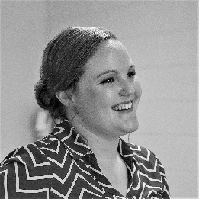
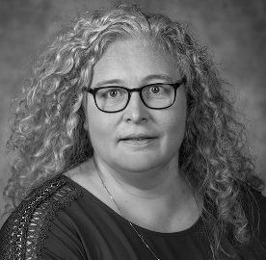
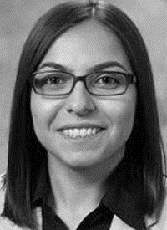
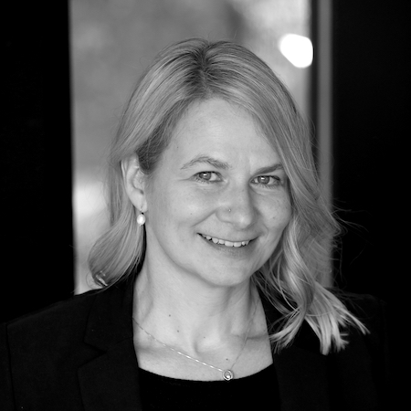
ISLT Full-Time Faculty
Faculty Member | Contact Information | Faculty Member | Contact Information
 | Dr. Diana Brandon Teaching Faculty I 3205A Stone Building (850) 644-8793 dbrandon2@fsu.edu |  | Dr. Kerry Burner M.S. Coordinator Advisor Teaching Faculty II (850) 645-1288 kburner@campus.fsu.edu
 | Dr. Secil Caskurlu Assistant Professor 2304B Stone Building (850) 644-9440 scaskurlu@fsu.edu |  | Dr. Vanessa Dennen ISLT Program Coordinator, Ed.D. Coordinator Professor 3205H Stone Building (850) 644-8783 vdennen@admin.fsu.edu

Slide 15
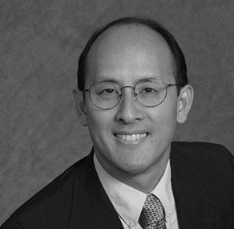
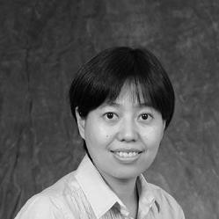
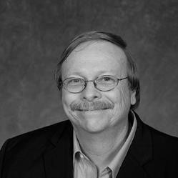
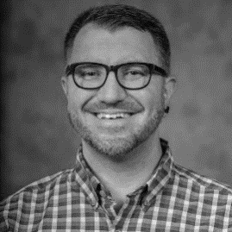
ISLT Full-Time Faculty
Faculty Member | Contact Information | Faculty Member | Contact Information
 | Dr. Allan Jeong Certificate Coordinator Associate Professor 3205E Stone Building (850) 644-8784 ajeong@admin.fsu.edu |  | Dr. Fengfeng Ke Professor 3205F Stone Building (850) 644-8794 fke@admin.fsu.edu
 | Dr. James D. Klein Professor 3206N Stone Building (850) 644-8789 jklein@fsu.edu |  | Dr. Bret Staudt Willet Ph.D. Coordinator Assistant Professor 3205G Stone Building (850) 644-8785 bret.staudtwillet@fsu.edu

Slide 16
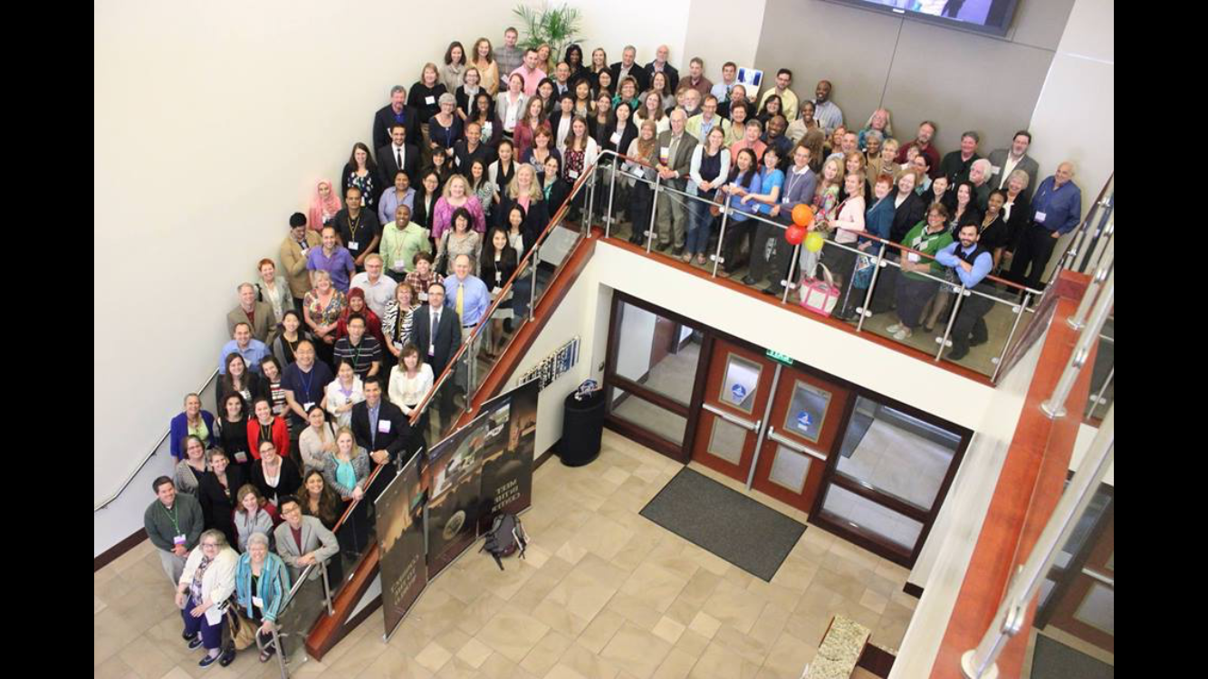
What makes ISLT special?
Top ranking in USNWR
Strong alumni network
Mentoring program
Faculty authored 3 of top 5 texts
Engaging, interactive classes
Low student:instructor ratio
Active student association

Slide 17
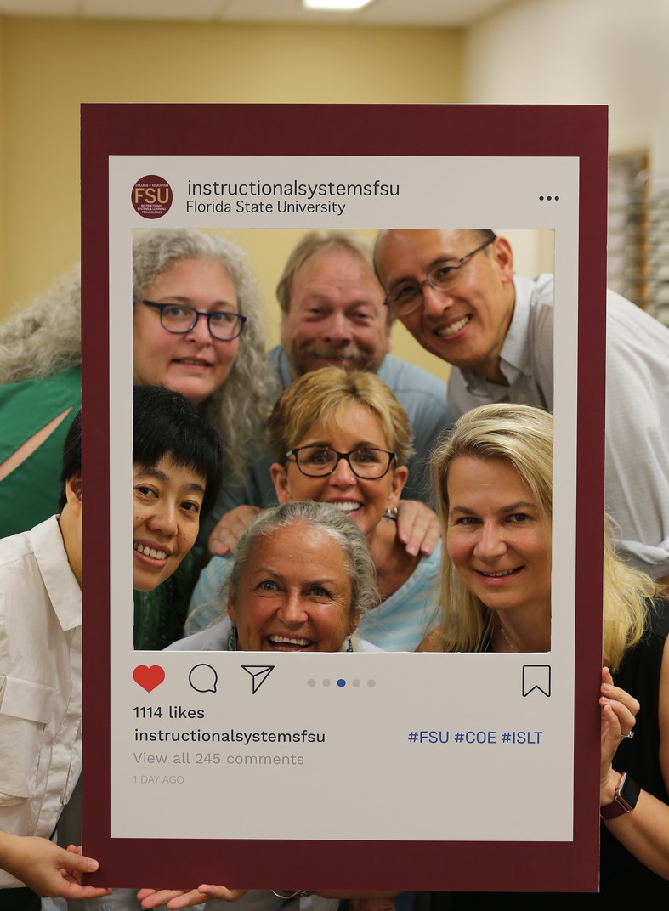
Connect with us!
Twitter: @ISLT_FSU
Instagram: @instructionalsystemsfsu
Facebook:
www.facebook.com/ISLTFSU/
facebook.com/groups/instructionalsystems
Blog:
http://isfsu.blogspot.com
For Program Info Contact:
Jennifer Walsh
Academic Program Specialist
(850) 644-8780
jnwalsh@fsu.edu

Slide 18
PhD Combined Counseling and
School Psychology
Program Overview
  APA-accredited
  4-7 years (with a 1-year internship)
Career Opportunities
  Academia
  Psychologists in a variety of settings
    Private Practice
    Counseling Centers
    Veterans Affairs
Multiple Research Opportunities
  Bullying
  Suicide Prevention
  Addiction and Rehabilitation
  Racial Discrimination and Health
  Career Development
  Mathematics Learning
Assistantships/Fellowships/Scholarships
  Some available through the department, the college, and other places around campus (but cannot be guaranteed).
Diverse Practicum Opportunities
  Onsite (e.g., ALEC, HSC) and offsite (e.g., FAMU, Career Center)
Value diversity/social justice
  Diversity townhalls
  Diversity events every semester
FAQS
  www.APA.org
  ~12 students admitted a year

Slide 19
PhD Combined Counseling and School Psychology
Admission Requirements
1. A bachelor’s degree with at least a 3.0 GPA – An earned bachelor’s degree from a regionally accredited U.S. institution, or a comparable degree from an international institution, with a minimum 3.0 (on a 4.0 scale) grade point average (GPA) in all coursework attempted while registered as an upper-division undergraduate student working towards a bachelor’s degree.
OR
A graduate degree with at least a 3.5 GPA –An earned graduate degree from a regionally accredited U.S.
institution, or a comparable degree from an international institution, with a minimum 3.5 (on a 4.0 scale) grade point average (GPA).
2. GRE Targets: 150 or above (verbal), 148 or above (quantitative), 4.0 or above (analytical)
3. Personal Statement
4. Transcripts
5. Letters of Recommendations
6. Resume/CV

Slide 20
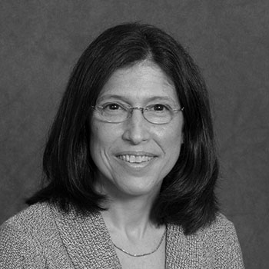
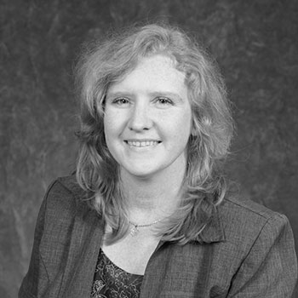
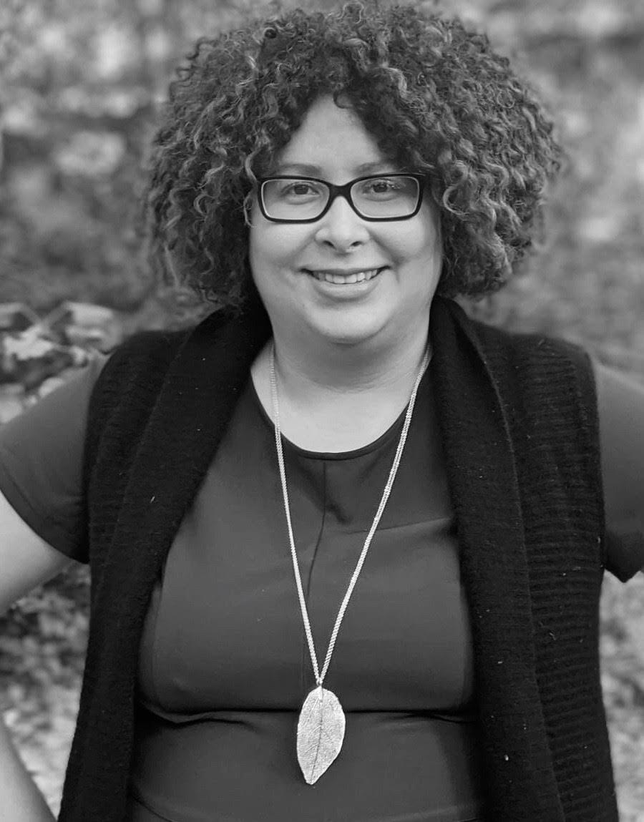
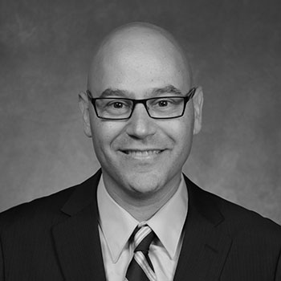
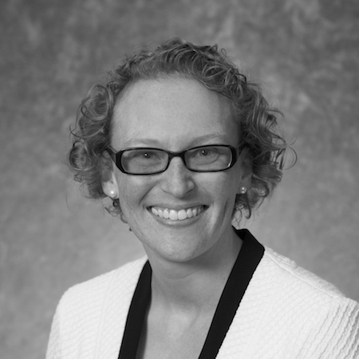
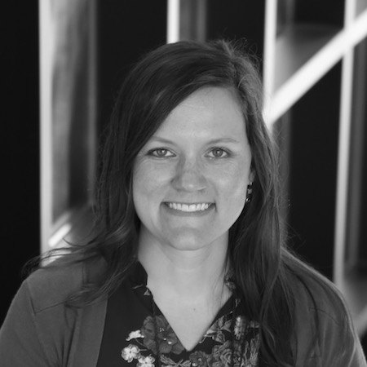
Program
Faculty
Dr. Deborah Ebener
Director of Clinical Training
Dr. Debra Osborn
Co-Director of Training
Blue frame: Counseling Psychology Faculty
Garnet Frame: School Psychology Faculty
Purple Frame: Clinical Faculty
Dr. Lyndsay Jenkins
Dr. Garret Hall
Dr. Laura Reid Marks
Dr. Martin Swanbrow-Becker
Dr. Casey Dozier
Dr. Taylor Thompson

Slide 21
Counseling and Human Systems:
Counselor Education Majors

Slide 22
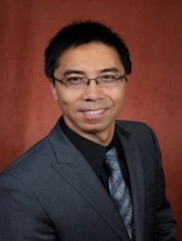
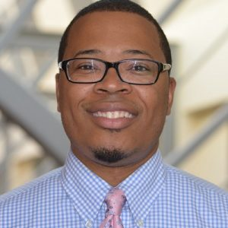
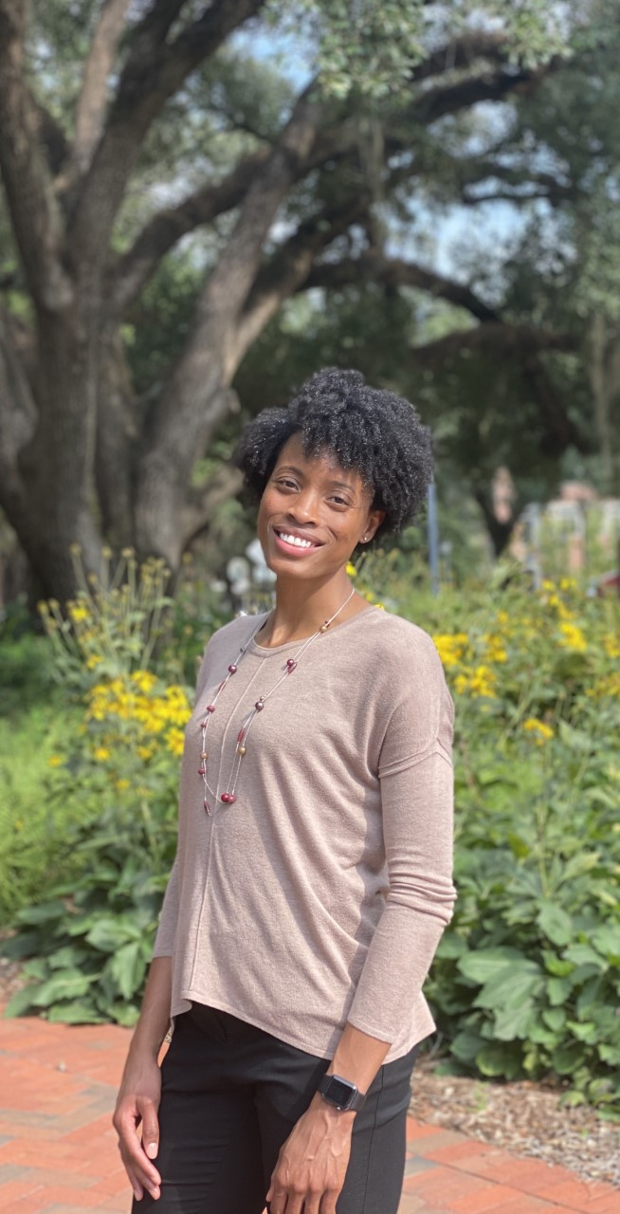
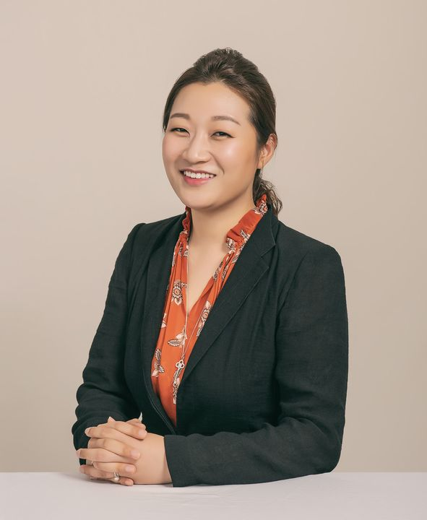
Dr. Shengli Dong
sdong3@fsu.edu
(850) 645-0344
Stone Building (3206J)
Dr. Shengli Dong
sdong3@fsu.edu
(850) 645-0344
Stone Building (3206J)
Dr. Erik Hines
emhines@fsu.edu
(850) 644-8796
Stone Building (3206E)
Dr. Simone May
vmay@fsu.edu
(850) 645-3503
Stone Building (3206M)
Dr. Eunhui Yoon
eyoon@fsu.edu
(850) 645-9444
Stone Building (3205B)

Slide 23
Counseling and Human Systems:
Counselor Education Majors
Career Counseling - Prepare professional career counselors who work in various settings (e.g., schools, community colleges, universities, businesses) to help students, teachers, parents, and others with career and educational decision making.
Clinical Mental Health Counseling - Prepare professional counselors who work in various settings such as hospitals, community agencies, prisons, and independent practices to assist individuals with their mental health.
School Counseling - Prepare professional school counselors to work in multiple school settings (urban, suburban, and rural) with students and use skills such as individual and group counseling, cultural responsiveness, and data-based decision making.

Slide 24
Career Counseling
61 credit hours, full time, 5 semesters, full time program (Fall admission ONLY: application deadline April 1st)
3 semesters of clinical experience in college, school, or community settings
CACREP-accredited program
Opportunity to be eligible for licensure as a Licensed Mental Health Counselor in the state of Florida
Career scholarships and graduate assistantship opportunities available
Work in career counseling, career placement, academic advising, and professional counseling

Slide 25
Clinical Mental Health Counseling (CMHC)
60-credit hours, 5 consecutive semesters, full time program (Fall admission ONLY: application deadline, December 1st)
3 semesters of clinical experience in diverse community agencies and clinical settings
Combined master’s and education specialist degree (M.S./Ed.S.)
CACREP-accredited program that prepares you for state licensure
Career opportunities in university counseling centers, behavioral health care, residential and in-home therapy, substance abuse/addictions counseling, secondary schools, and private practice, etc.
Some assistantships available

Slide 26
School Counseling
60-credit hours, fully online program, 8 consecutive semesters, part time program (Fall admission ONLY: application deadline March 1st)
Combined master’s and education specialist degree (M.S./ Ed.S.)
Practicum & Internship
  Two internship options (full time-1 semester, part time-2 semesters)
State of Florida approved educator program
Career opportunities: Significant demand for school counselors in P-12

Slide 27
Counselor Education Admission Requirements
A bachelor’s degree with at least a 3.0 GPA
GRE Waived
  GRE test scores
    Target Scores
      Verbal – 145 or above
      Writing – 3.5 or above
  Language proficiency test scores
    Target Scores
      TOEFL (paper-based) – 550
      TOEFL (internet-based) – 80
      IELTS – 6.5
      MELAB – 77
Resume
Personal statement
3 letters of recommendation
Transcripts

Slide 28
School Psychology (M.S./Ed.S.)
School Psychologists:
  support students' abilities to learn and teachers' abilities to teach
  apply expertise in mental health, learning, and behavior, to help children and youth succeed academically, socially, behaviorally, and emotionally
  partner with families, teachers, school administrators, and other professionals to create safe, healthy, and supportive learning environments that strengthen connections among home, school, and the community

Slide 29
School Psychology (M.S./Ed.S.)
Program Overview
  73 credit hours
  Full-time 3 year program with 2 years of coursework and 1 year of internship
  3 semesters of practicum and 2 semesters of internship
  NASP-accredited
Career Opportunities
  Graduate primarily work in public schools as school psychologists
  100% job placement after graduation

Slide 30
School Psychology (M.S./Ed.S.)
Admission Requirements
  Bachelor’s degree with at least a 3.2 GPA
  GRE requirements waived for next admission cycle
  3 letters of recommendation
  Personal Statement
  Apply by December 1
FAQs
  Cohort size = 12 each year
  Assistantships available
  NASPonline.org

Slide 31
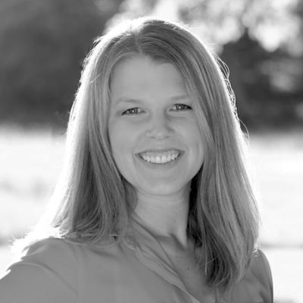
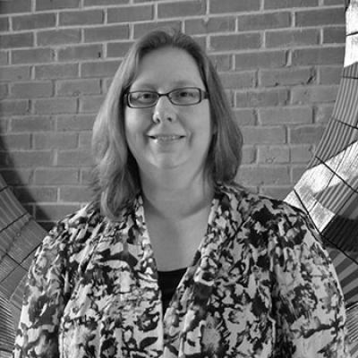
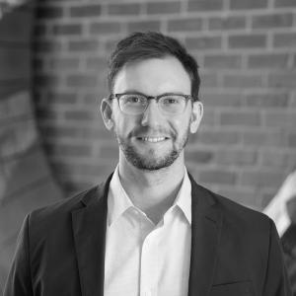
School Psychology (M.S./Ed.S.) Program Faculty
Lyndsay Jenkins, Ph.D
Kathleen Krach, Ph.D.
Program Coordinator
Garret Hall, Ph.D.

Slide 32
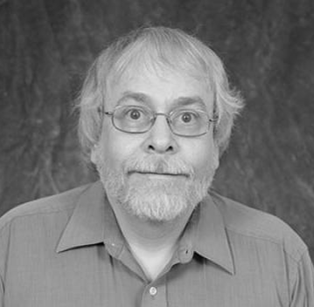
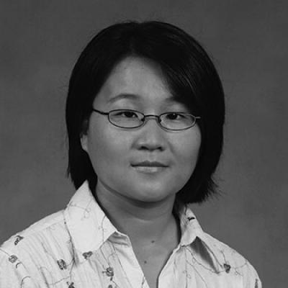
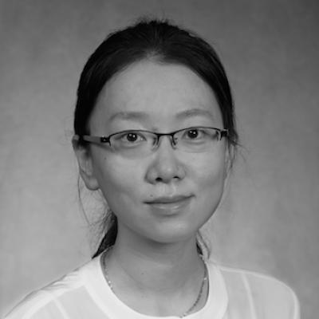
Measurement & Statistics (M.S. & PhD)
To prepare leaders in educational research to serve in various types of professional positions related to collecting, analyzing and interpreting educational statistics.
Program admissions contact: Jennifer Walsh, jnwalsh@fsu.edu
Dr. Russell Almond
Associate Professor
ralmond@fsu.edu
Dr. Yanyun Yang
Professor
Program Coordinator
yyang3@fsu.edu
Dr. Qian Zhang
Associate Professor
Online M.S. program coordinator qzhang4@fsu.edu

Slide 33
Measurement & Statistics (M.S. & PhD)
The M.S. program (both face-to-face and online) emphasizes on building preliminary skills in educational measurement theory, statistical analysis, and evaluation. The M.S. degree can also complement a higher degree in a related discipline, such as ELPS, L&C, S&P, or ISLT. The Ph.D. program emphasizes both advanced instruction and direct experience with educational measurement and applied statistics issues.
Example of Courses Offered:
  Foundation courses: General Linear Model Applications, Measurement Theory I
  Advanced courses: Causal Modeling, Multilevel Modeling, Theory of Scaling and Equating
Career Opportunities: Higher education, testing companies, Department of Education, etc.

Slide 34
Measurement & Statistics (M.S. & PhD)
Admission Requirements
  GPA: ≥ 3.0 for M.S.; ≥3.5 for PhD
  GRE: ≥ 50th percentile on both Verbal and Quantitative; ≥ 30th percentile on Analytical
  TOEFL: ≥ 80 (internet-based) or 550 (paper-based)
  3 letters of recommendation, personal statement, transcripts, and writing sample
Degree Requirements
  M.S.: 30 credit hours completed in 7 years
  PhD: all required courses beyond M.S.; milestone exams; dissertation
Graduate Assistantship Opportunities
  University and college fellowships
  Graduate teaching and research assistantships (TA, stat consultants, FLDOE interns)

Slide 35
Measurement & Statistics Certificate Program
Goal: to prepare students to be trained in data analysis skills using quantitative applied statistical methods and educational/psychological measurement
Who can apply? Non-M&S degree program students and non-degree seeking students who have a bachelor’s degree
How to apply? Prior to completing two M&S certificate program courses, complete the M&S certificate application form found at education.fsu.edu/measurement-stats-cert.
Required courses: 5 required courses (16 credit hours) within 7 years, with “B” or higher letter grade.
M&S certificate program coordinator: Dr. Qian Zhang, qzhang4@fsu.edu

Slide 36
Sport Psychology (MS & PhD)
Program Overview:
  Learn about theory, research, and real-world practice of sport psychology
  Join research teams, build research skills, work in our lab
  Work with performers to promote performance-enhancing mental skills
    Supervision provided to work towards Certified Mental Performance Consultant (CMPC) status
Example of Courses Offered:
  Emotions and Emotion Regulation
  Group Dynamics in Sport
  Stress and Performance
Career Opportunities:
  Higher education, mental performance consulting, research directors, sport science directors, student-athlete services, coaching, strength and conditioning, life coaching, more…

Slide 37
Sport Psychology (MS & PhD)
Admission requirements:
  GPA
    MS: 3.0 minimum
    PhD: 3.5 minimum
  GRE
    MS: Waived through 2026
    PhD: Verbal – 50th percentile, Quantitative – 50th percentile, Analytical – 3.5
  Personal statement, CV / resume, transcripts, 3 letters of recommendation
More information and contact:
  https://education.fsu.edu/sport-psychology
  Program contact: Dr. Brian Foster (bjfoster@fsu.edu)
  Admissions contact: José Cruz-Torres (jmc11n@fsu.edu)

Slide 38
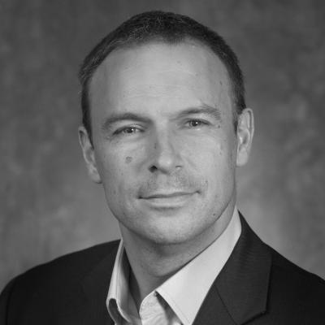
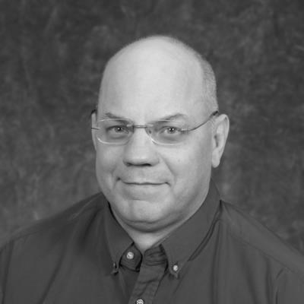
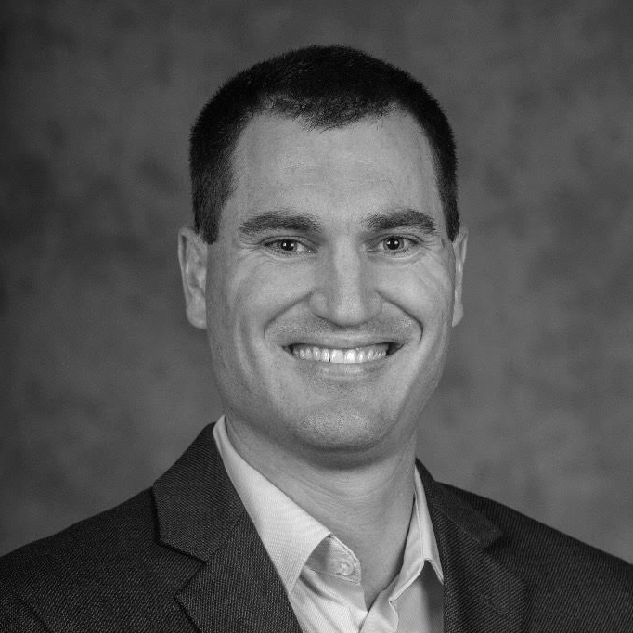
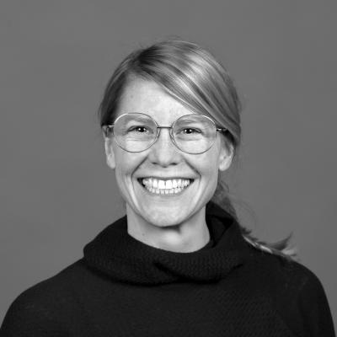
Sport Psychology Faculty
Dr. David Eccles
Professor
Dr. Robert Eklund
Professor and Associate Dean
Dr. Brian Foster
Teaching Faculty I
Dr. Svenja Wolf
Assistant Professor

