Slide 1

Data Visualization for Education Research
Class 1 – 01/06/20
Christine Mokher, Ph.D.
R3 Presentation
October 13, 2021

Slide 2
“Raise your hand if your approach to creating a graph goes something like this: You analyze some data, write up the results. Make a graph and drop it into the report, surrounded by text. Label it something benign like ‘Figure 1. Average Earnings, 1990-2020.’ Save it as a PDF. Post it to the world.”
Schwabish, 2020
  Better data visualizations: A guide for scholars, researchers, and wonks
Notes:
May have taken months or even years to compile and analyze data, and write the report
But many people quickly make graphs in Excel using default formatting
Most important think to consider in communicating your work is the audience. People will read your report. Need to think about the best way to present our findings.

Slide 3
Agenda
Introduction to data visualization
5 principles for better visualizations
How to utilize different types of visualizations
    Descriptive statistics
    Survey data
    Regression results
    Qualitative analyses
Demonstration in Excel
Resources for learning more about data visualization

Slide 4
Introduction to data visualization
Agenda:
Introduction to data visualization
5 principles for better visualizations
How to utilize different types of visualizations
Demonstration in Excel
Resources for learning more about data visualization

Slide 5
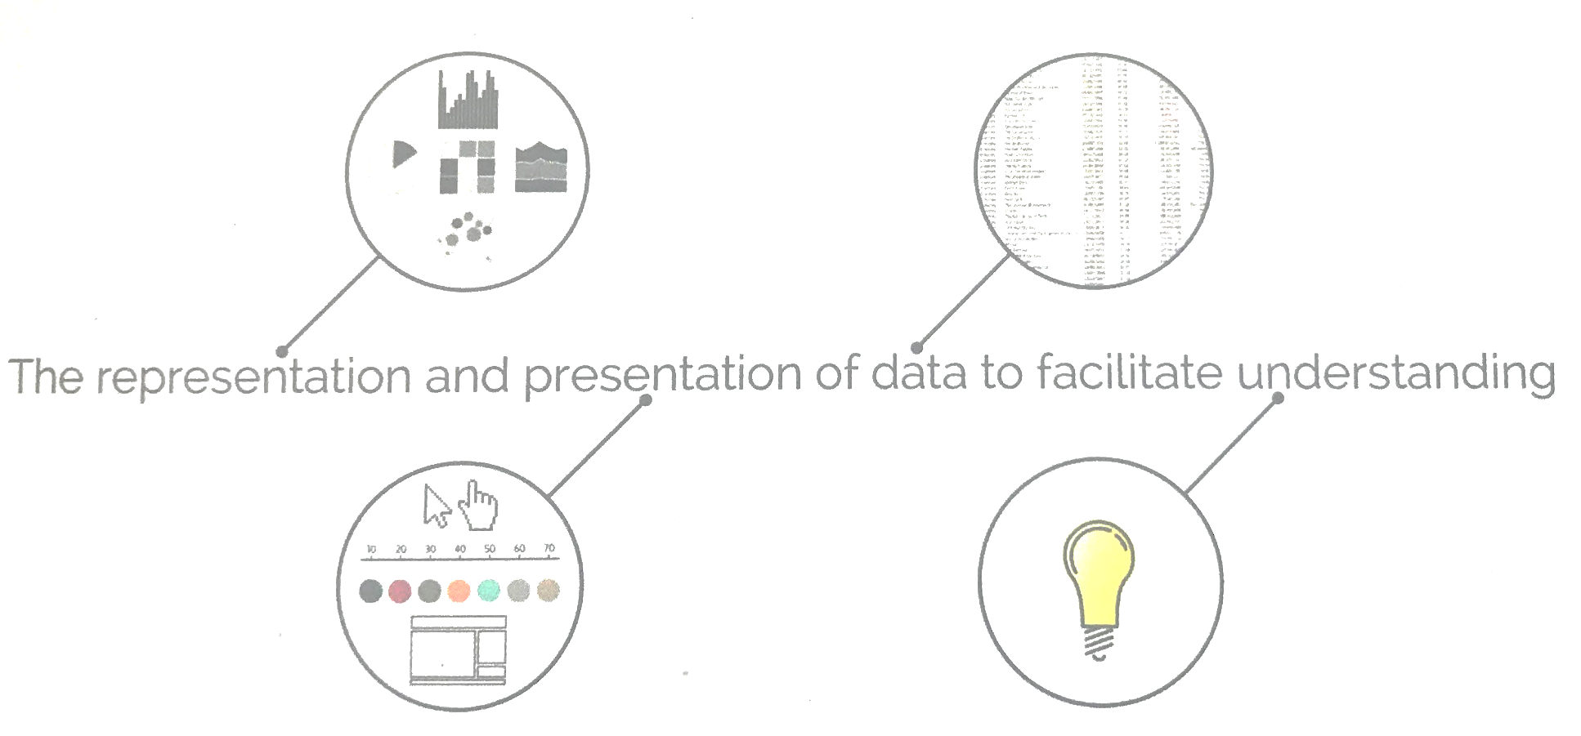
What is data visualization?
Kirk, A. (2016). Data visualisation: A handbook for data driven design. Sage.
Notes:
What kind of decisions do we need to make a chart? (What type of chart – representation, what the chart is going to look like – presentation)
What is the purpose of making the chart? To facilitate understanding

Slide 6
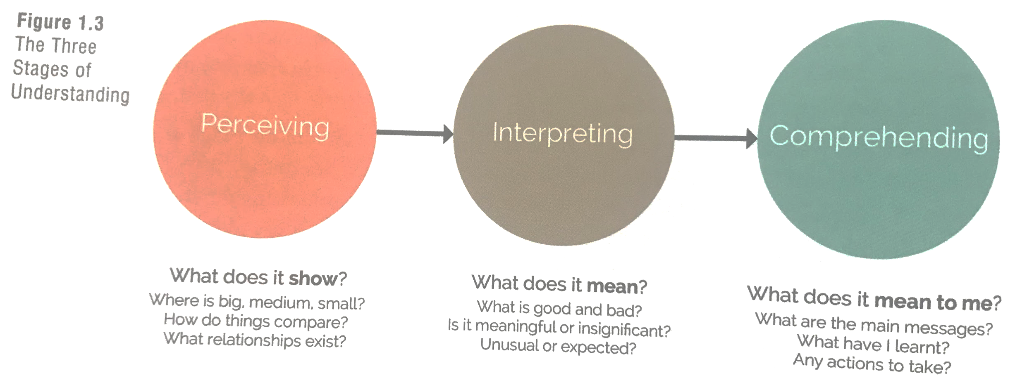
Why is data visualization important?
Kirk, A. (2016). Data visualisation: A handbook for data driven design. Sage.

Slide 7
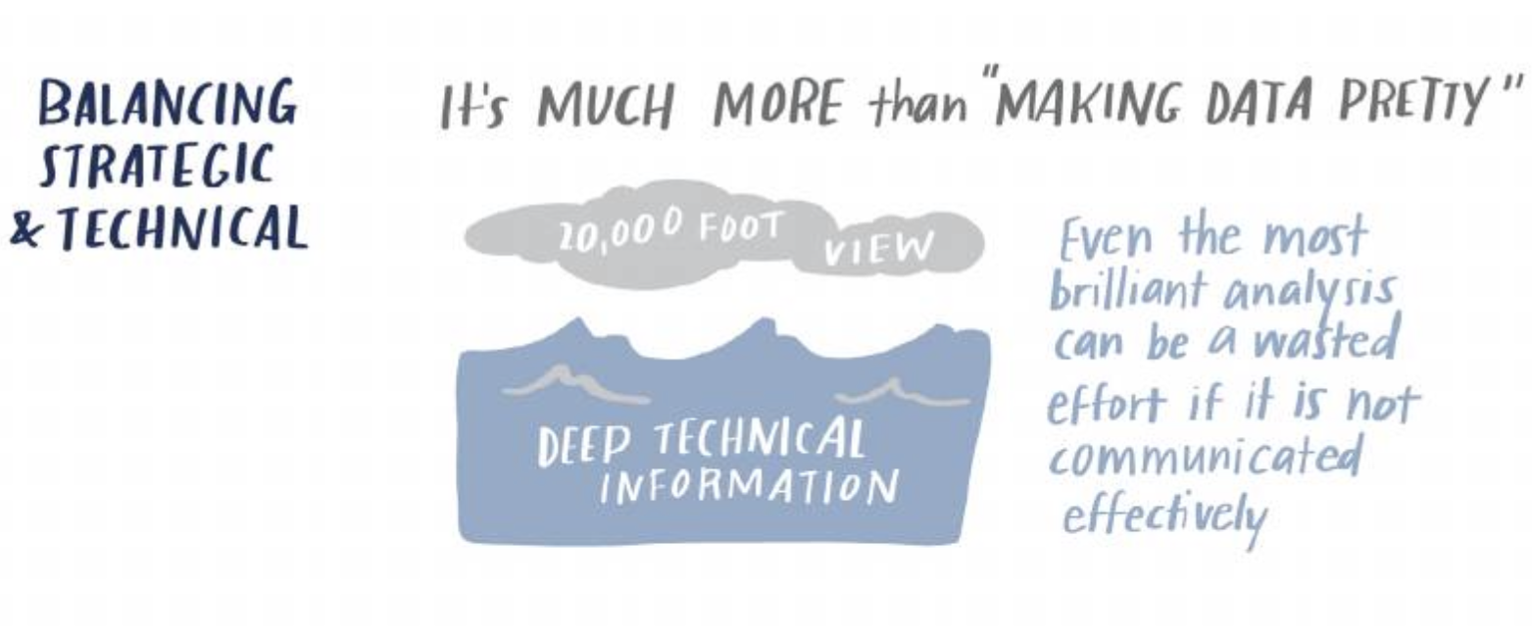
Knaflic, C. N. (2015). Storytelling with data: A data visualization guide for business professionals. John Wiley & Sons.
Notes:
Important of you want to go into an administrative career and will be working with practitioners
Just as important if you want to go into an academic career and you want your research to be read by audiences beyond just other academics

Slide 8
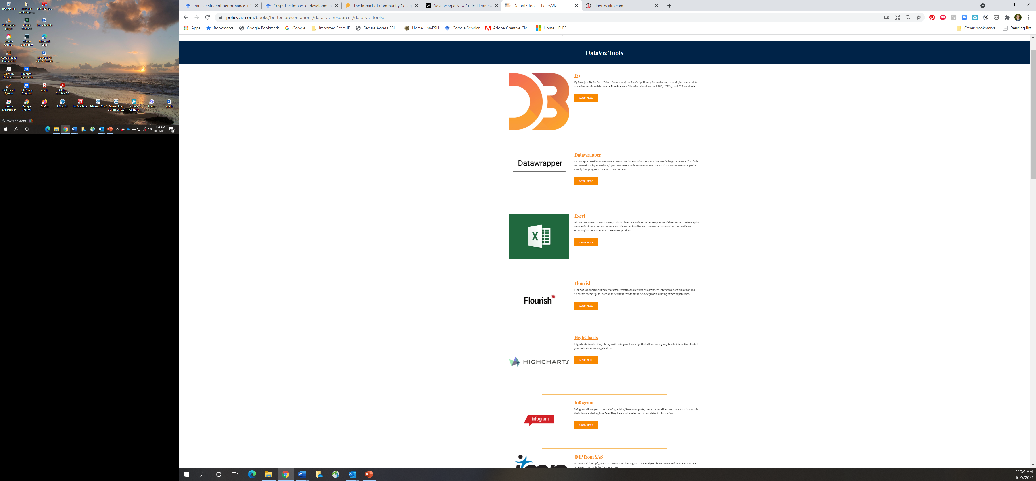



What types of tools are used to create visualizations?
https://policyviz.com/books/better-presentations/data-viz-resources/data-viz-tools/

Slide 9
Why Excel is the best option for most education researchers?
Easy to learn
    Spend your time learning an analytic program like Stata or NVivo instead
Almost organizations have it
    Avoid expensive licenses and monthly fees
Better for collaborative work
    Others can easily modify your visualizations
Notes:
Raise your hand if you’ve ever used Excel and have at least a basic knowledge of how to use it?
Now raise your hand if you’ve ever worked in an office and had a computer that did not have Excel on it?

Slide 10
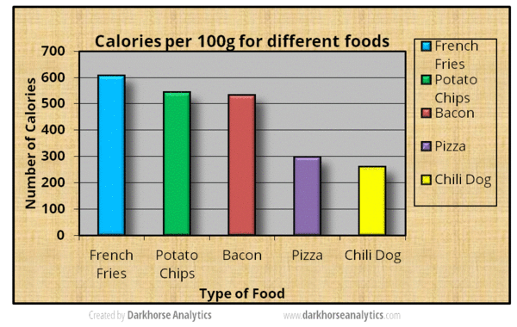
What’s wrong with this picture?
Source: Darkhorse Analytics

Slide 11
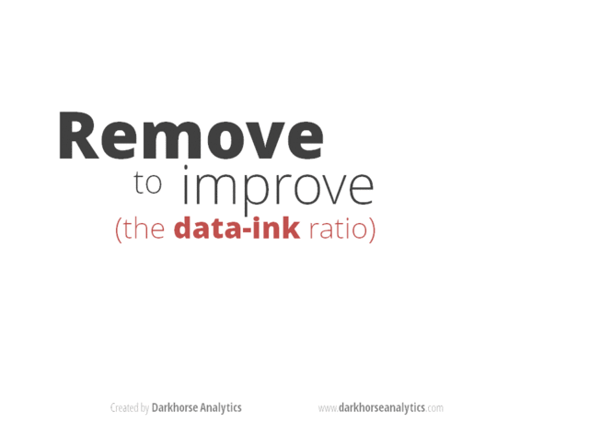
What’s wrong with this picture?
Source: Darkhorse Analytics

Slide 12
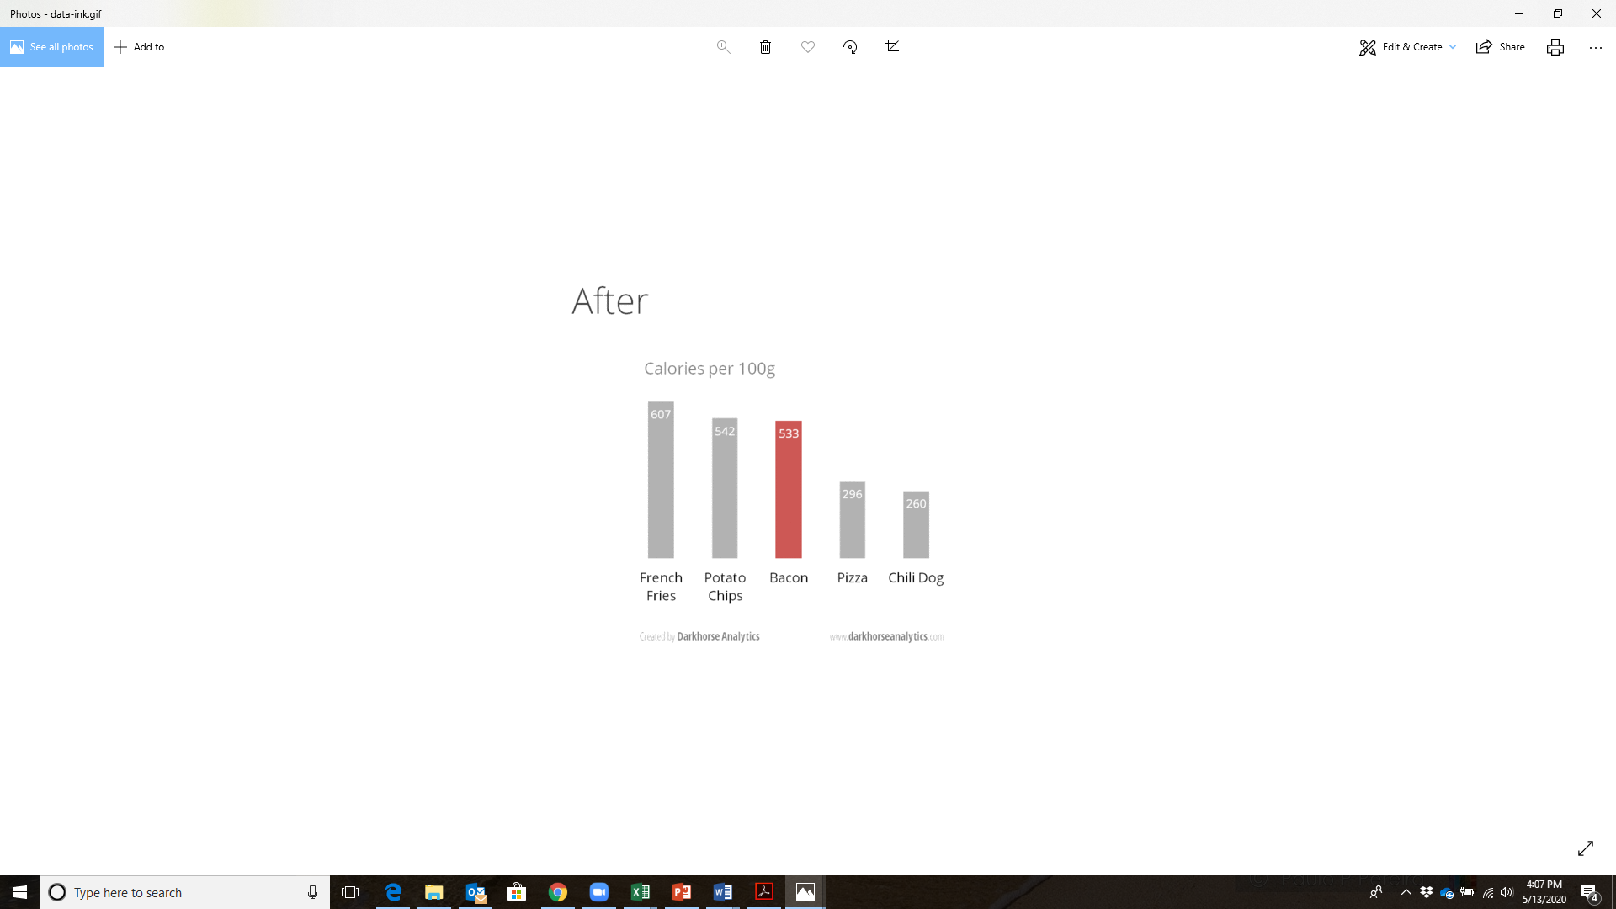
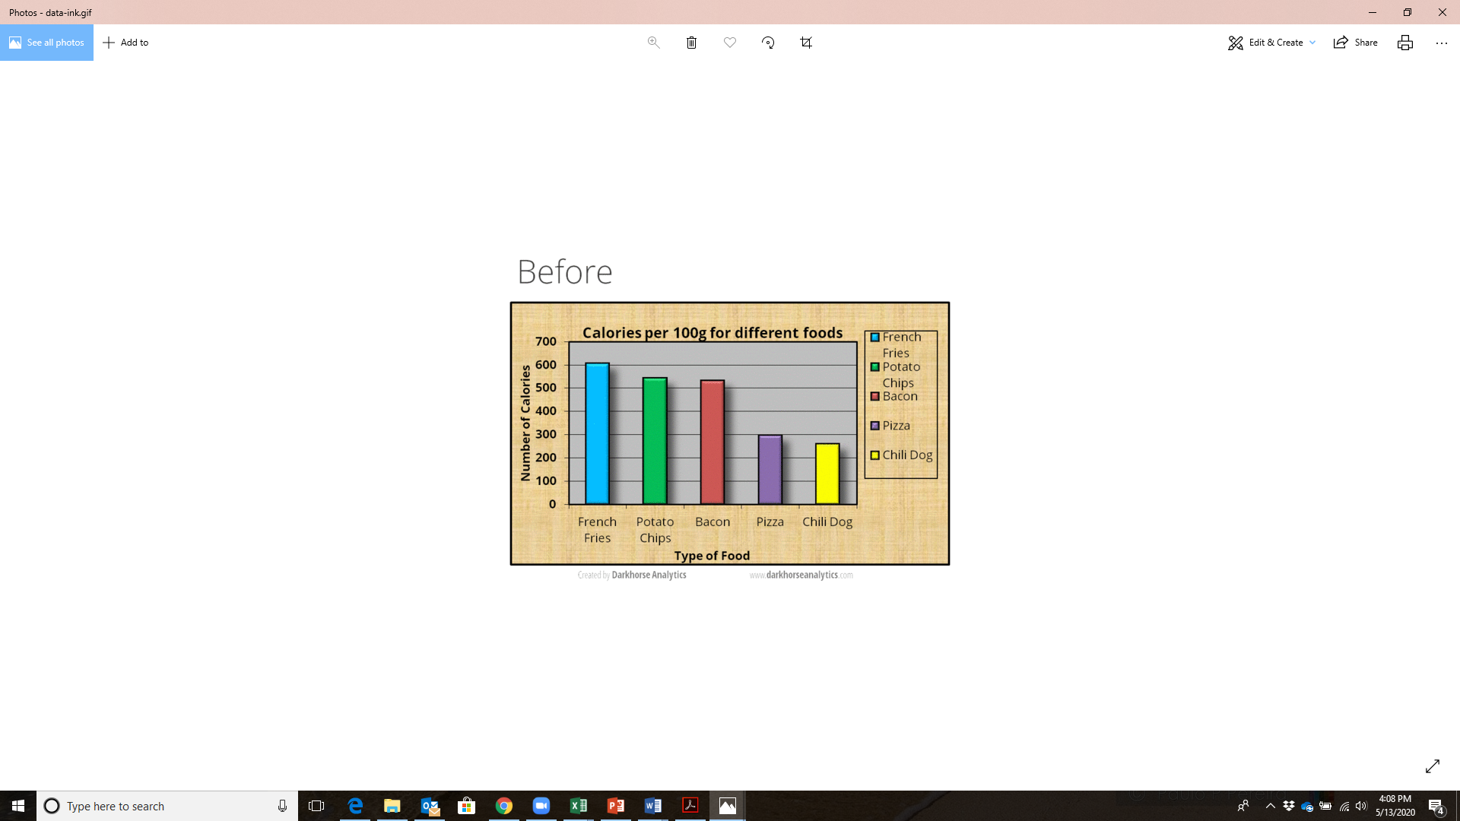
What’s wrong with this picture?
Source: Darkhorse Analytics
Notes:
- Excel first released in 1987 – actually looked like this

Slide 13
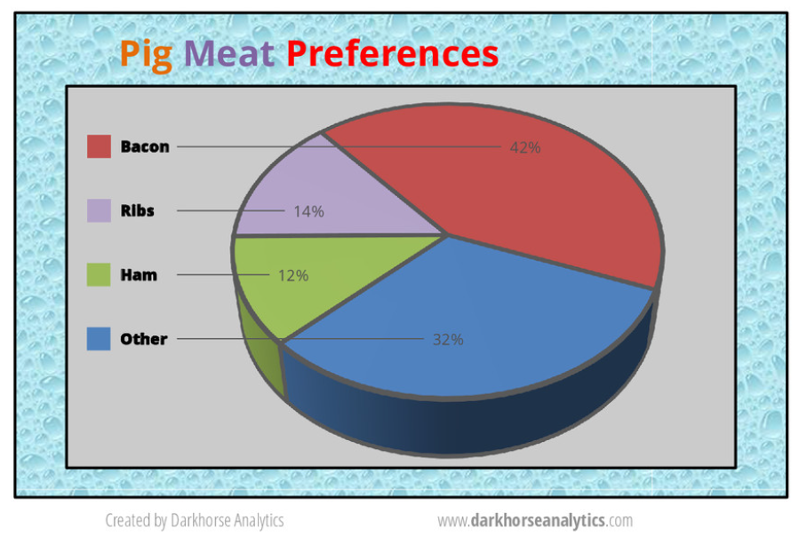
What’s wrong with this picture?
Source: Darkhorse Analytics

Slide 14
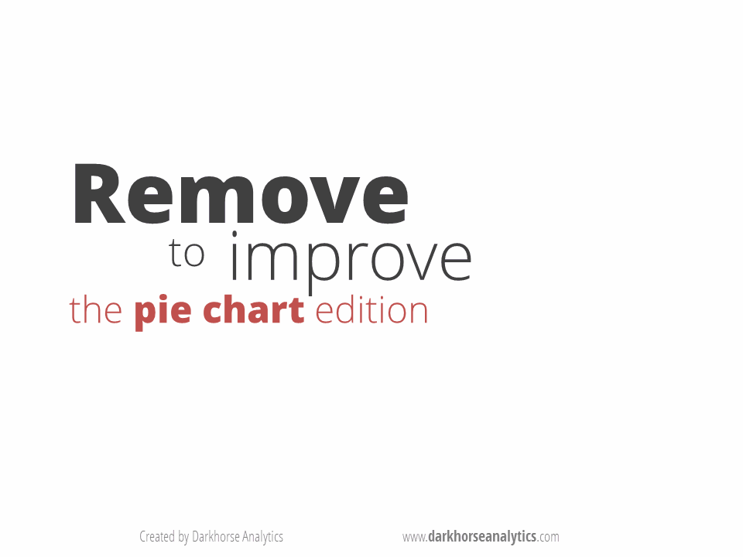
What’s wrong with this picture?
Source: Darkhorse Analytics

Slide 15
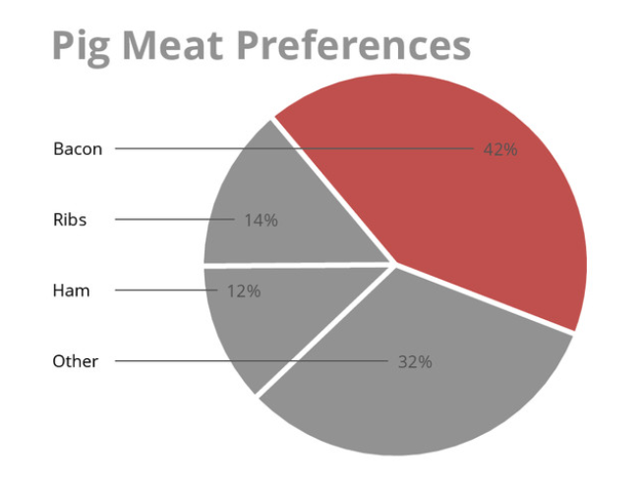
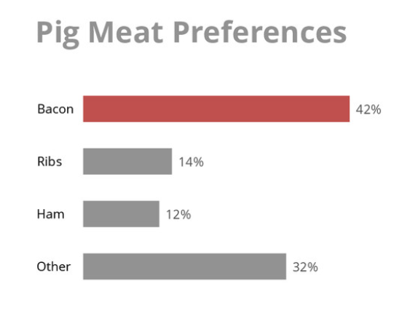
What’s wrong with this picture?
Source: Darkhorse Analytics

Slide 16
5 principles for better visualizations
Agenda:
Introduction to data visualization
5 principles for better visualizations
How to utilize different types of visualizations
Demonstration in Excel
Resources for learning more about data visualization

Slide 17
Differentiating indicators of data culture types
5 principles for better visualizations
  Show the data
  Reduce the clutter
  Integrate the graphics and the text
  Avoid the spaghetti chart
  Start with gray
Schwabish, J. (2020). Better data visualizations: A guide for scholars, researchers, and wonks. Columbia University Press.
.

Slide 18
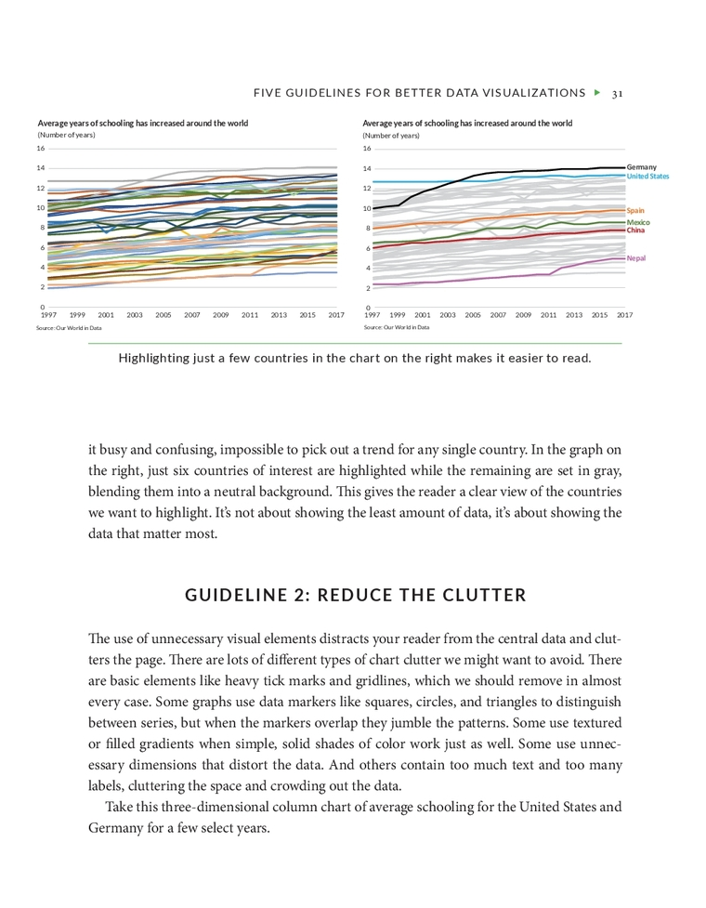
Show the Data
Not all the data must be shown, but the values important to the argument should be highlighted
Notes:
Both charts show average number of years of schooling in 50 countries around the world
First chart is busy and confusing, impossible to pick out a trend for any single country
Second chart highlights a few countries of interest while the remainder are set to grey – gives the readers clear view of countries we want to highlight
Not about showing the least amount of data, but showing the data that matter most

Slide 19
Differentiating indicators of data culture types
5 principles for better visualizations
  Show the data
  Reduce the clutter
  Integrate the graphics and the text
  Avoid the spaghetti chart
  Start with gray
Schwabish, J. (2020). Better data visualizations: A guide for scholars, researchers, and wonks. Columbia University Press.
.

Slide 20
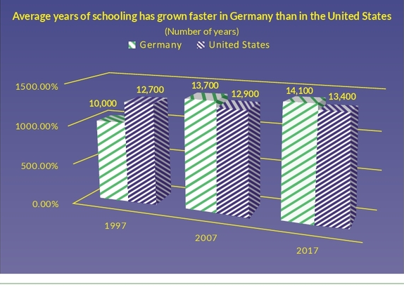
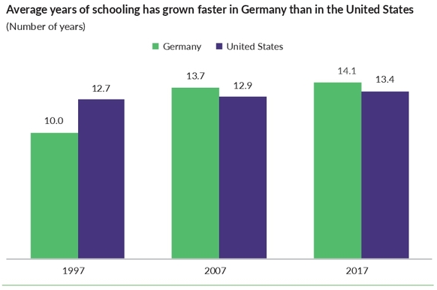
Reduce the clutter
Remove unnecessary visual elements that may distract the reader from the central data such as a heavy tick marks or gridlines, overlapping markers, textured gradients, and too much text.

Slide 21
Differentiating indicators of data culture types
5 principles for better visualizations
  Show the data
  Reduce the clutter
  Integrate the graphics and the text
  Avoid the spaghetti chart
  Start with gray
Schwabish, J. (2020). Better data visualizations: A guide for scholars, researchers, and wonks. Columbia University Press.
.

Slide 22
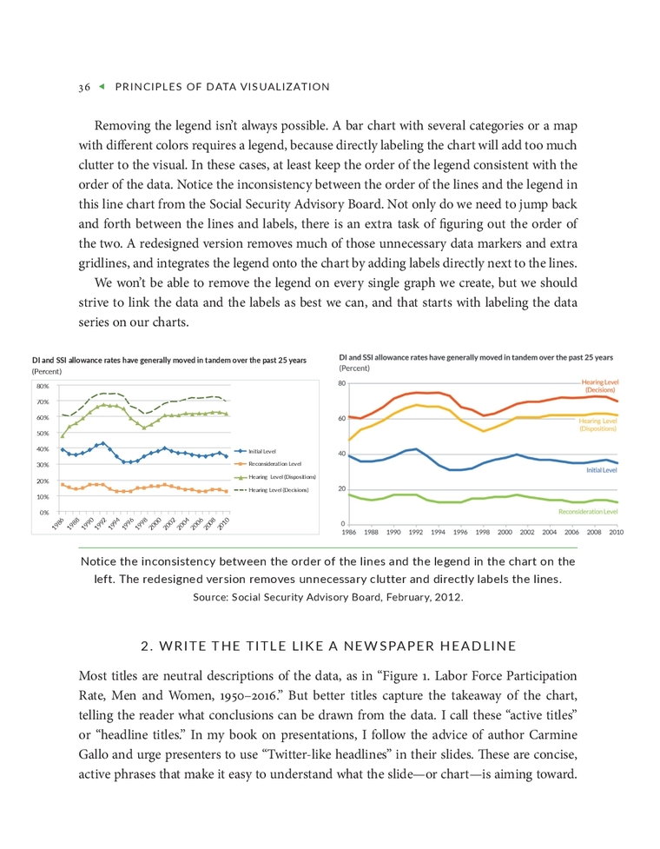
Integrate the graphics and the text
Remove legends when possible and label data directly

Slide 23
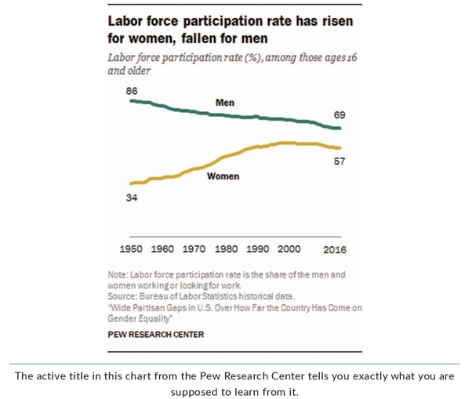
Integrate the graphics and the text
Write the title like a newspaper headline
Notes:
Also referred to as “Twitter-like headlines” – concise, active phrases that make it easy to understand the point or argument we want to make

Slide 24
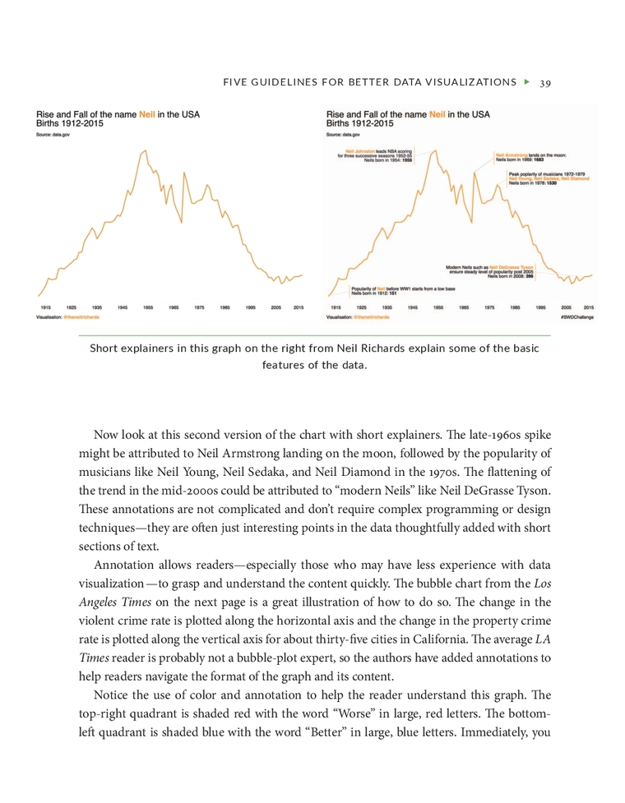
Integrate the graphics and the text
Add explainers if necessary

Slide 25
Differentiating indicators of data culture types
5 principles for better visualizations
  Show the data
  Reduce the clutter
  Integrate the graphics and the text
  Avoid the spaghetti chart
  Start with gray
Schwabish, J. (2020). Better data visualizations: A guide for scholars, researchers, and wonks. Columbia University Press.
.

Slide 26
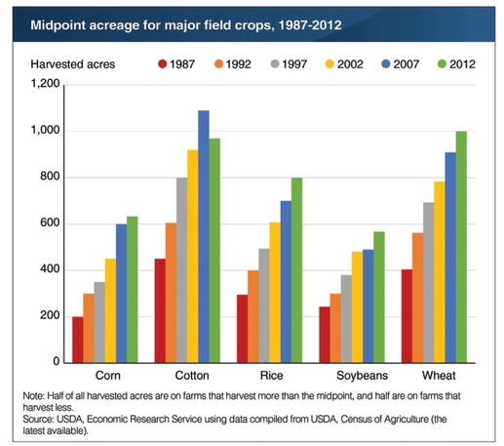
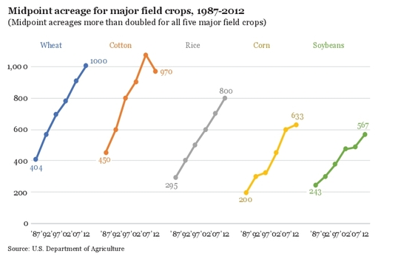
Avoid the spaghetti chart
Don’t include too much information in a single graph

Slide 27
Differentiating indicators of data culture types
5 principles for better visualizations
  Show the data
  Reduce the clutter
  Integrate the graphics and the text
  Avoid the spaghetti chart
  Start with gray
Schwabish, J. (2020). Better data visualizations: A guide for scholars, researchers, and wonks. Columbia University Press.
.

Slide 28
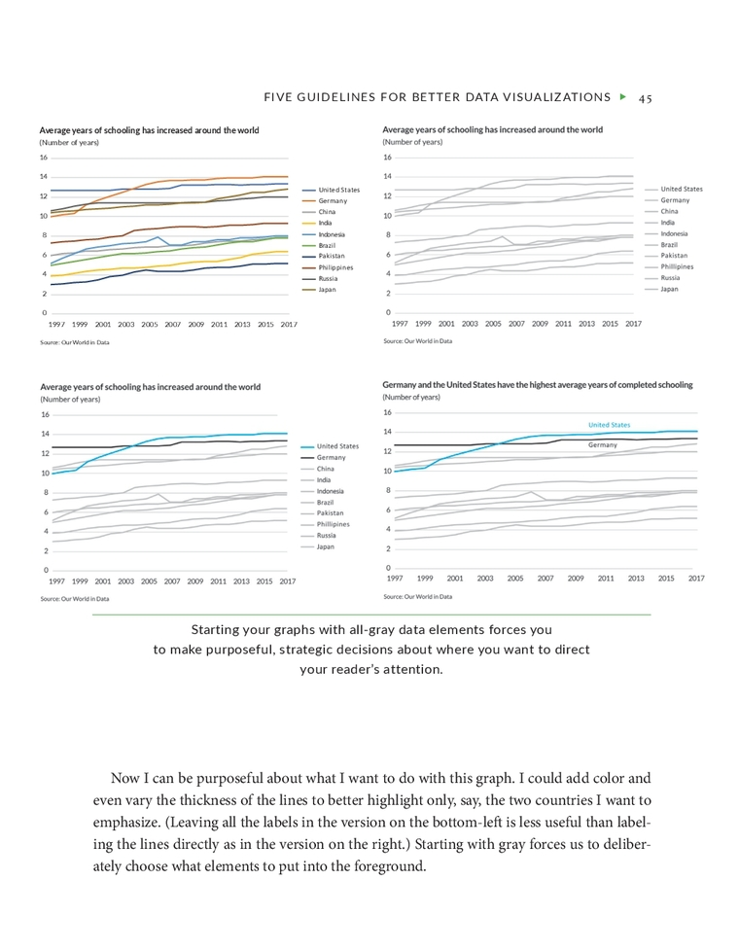
Avoid the spaghetti chart
Demonstrate a purposeful use of color

Slide 29
How to utilize different types of visualizations
Agenda:
Introduction to data visualization
5 principles for better visualizations
How to utilize different types of visualizations
Demonstration in Excel
Resources for learning more about data visualization

Slide 30
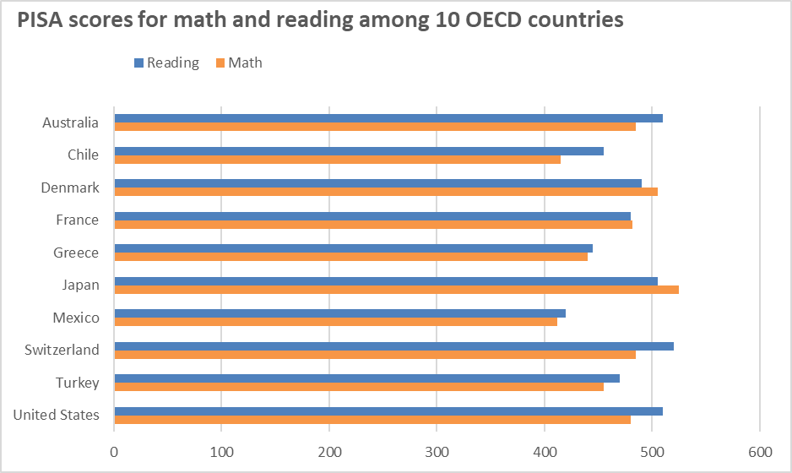
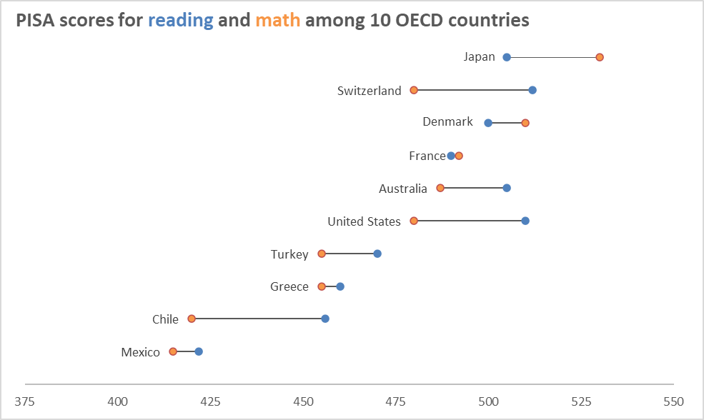
Descriptive statistics
Typical display
A better alternative: dot plot

Slide 31
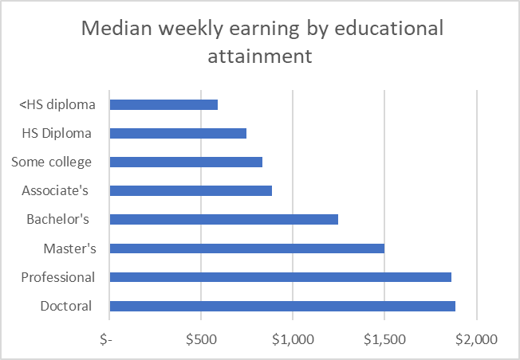
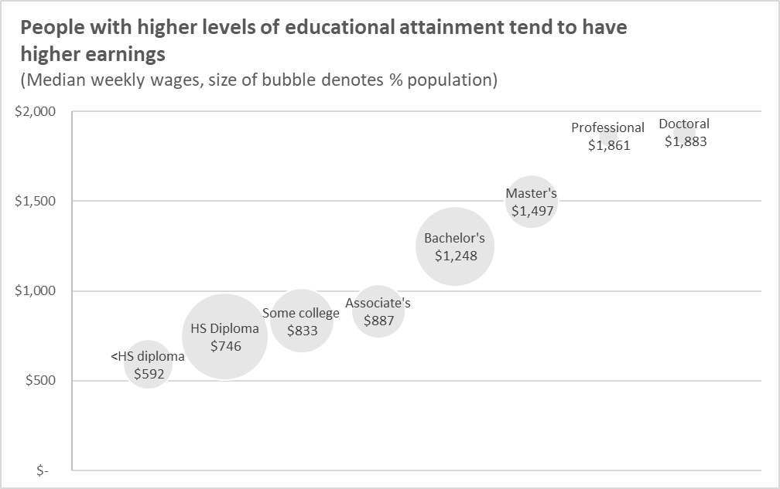
Descriptive statistics
Typical display
A better alternative: bubble plot

Slide 32
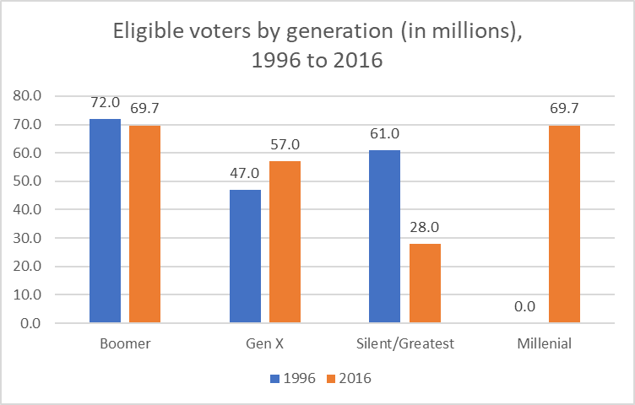
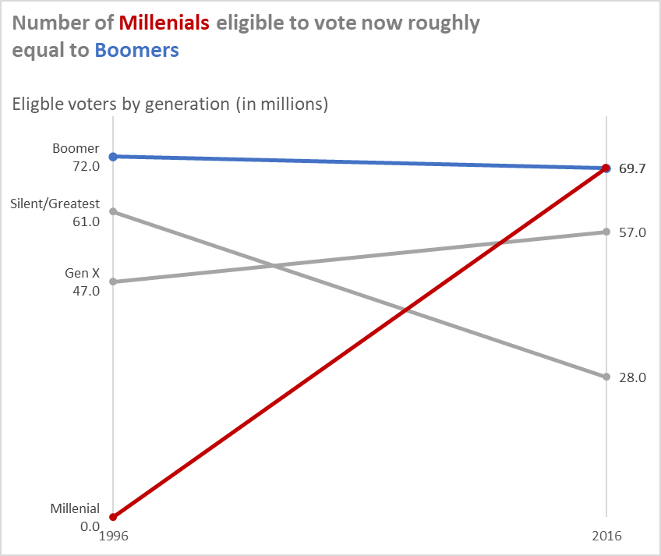
Descriptive statistics
Typical display
A better alternative: slope graph

Slide 33
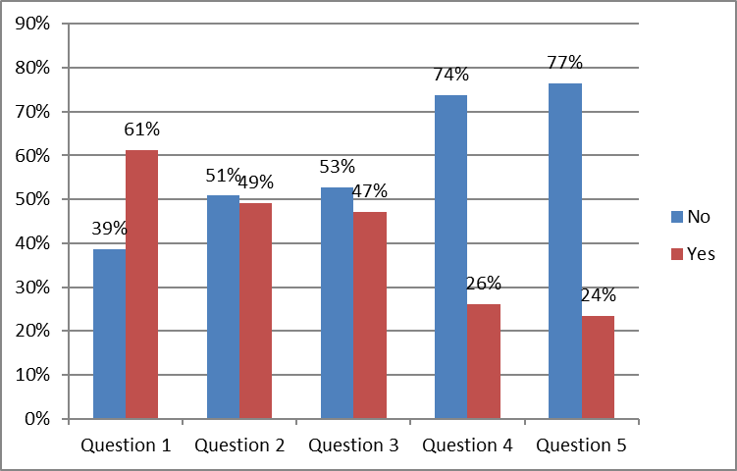
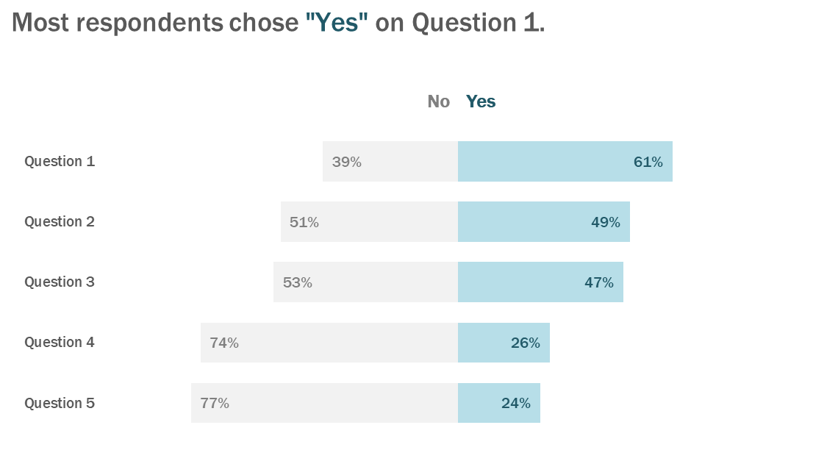
Survey data
Typical display
A better alternative: diverging stacked bars

Slide 34
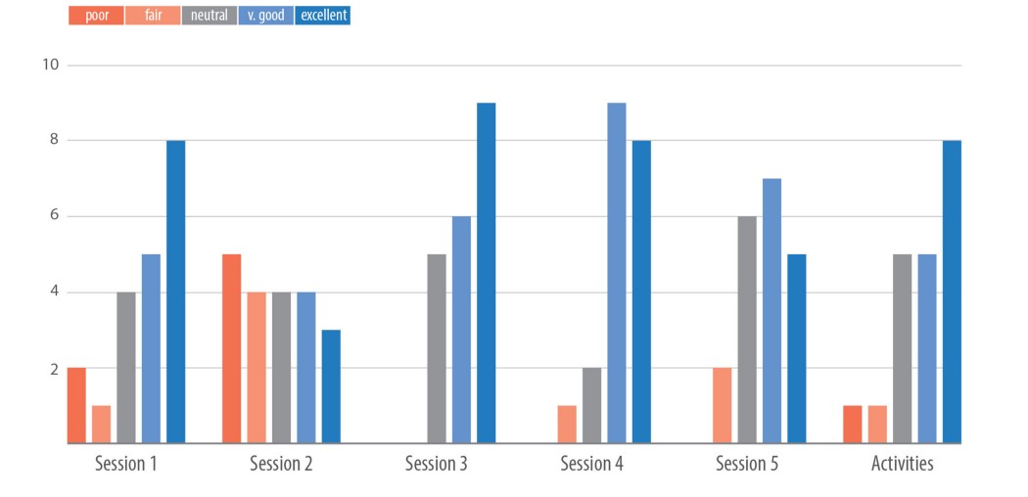
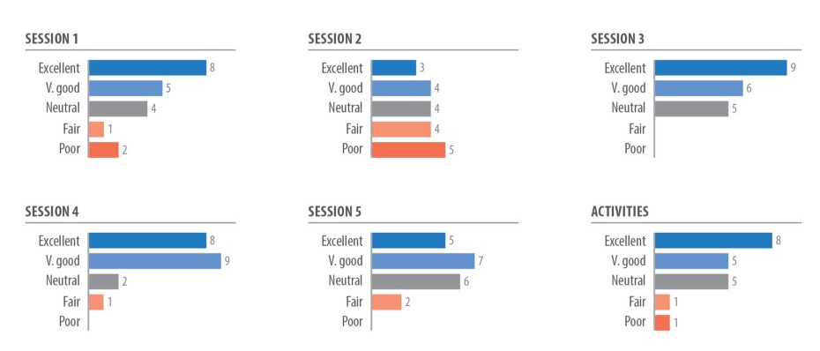
Survey data
Typical display: Grouped bar chart
A better alternative: Small multiples
Source: https://medium.com/nightingale/seven-different-ways-to-display-likert-scale-data-d0c1c9a9ad59

Slide 35
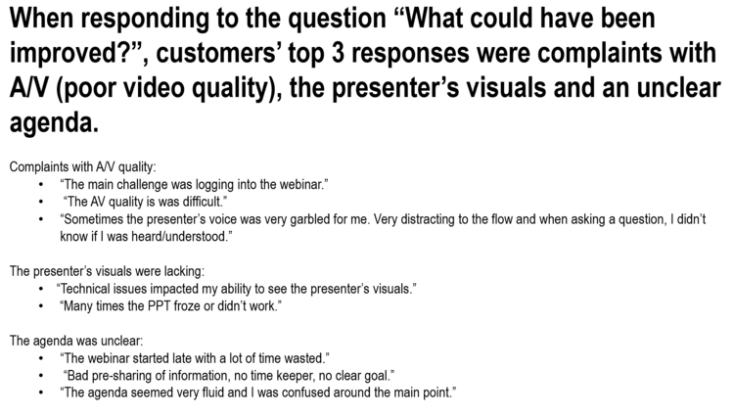
Survey data
Typical display
Source: http://www.storytellingwithdata.com/blog/2018/10/10/three-tips-for-storytelling-with-qualitative-data
Notes:
Examples from data viz websites - links will be provided under “Graphic Resources” module on Canvas
First example from Storytelling with data
Organization recently held a webinar for prospective customers and is collecting attendees’ feedback and reporting results to management.
Survey with some quantitative questions rating perceptions of different aspects of the webinar and an open-response section for qualitative comments
Here are some findings with verbatim comments from the open-ended responses about how the webinar could have been improved
Source: http://www.storytellingwithdata.com/blog/2018/10/10/three-tips-for-storytelling-with-qualitative-data

Slide 36
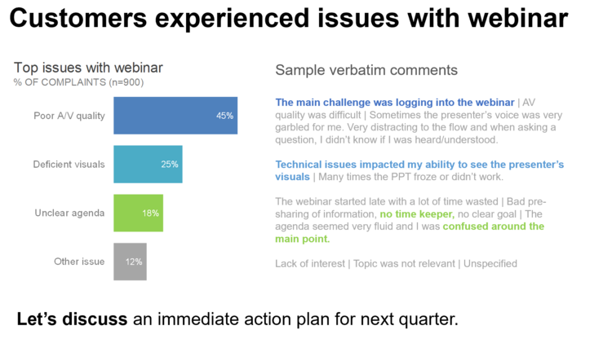
Survey data
A better alternative: integrate survey responses with comments
Source: http://www.storytellingwithdata.com/blog/2018/10/10/three-tips-for-storytelling-with-qualitative-data
Notes:
Here are 3 ways to make the presentation more effective:
Use color to draw the audience’s attention to the most important aspects.
Reduce the amount of text: more concise wording will help the audience process the information more efficiently.
Consider quantifying the data if doing so provides important context.
Source: http://www.storytellingwithdata.com/blog/2018/10/10/three-tips-for-storytelling-with-qualitative-data

Slide 37
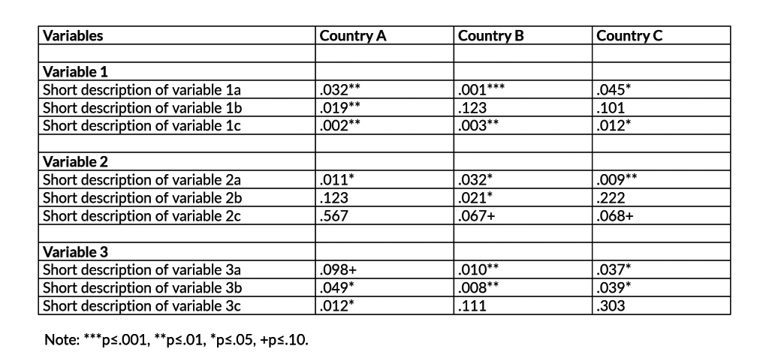
Regression results
Source: https://policyviz.com/2018/03/08/visualizing-statistically-significant-results/
Notes:
Results using regression analysis often include tables like the one shown here. This is ok for journal publications but not so good for quickly displaying key findings.
Source: https://policyviz.com/2018/03/08/visualizing-statistically-significant-results/

Slide 38
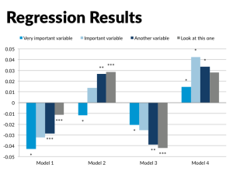
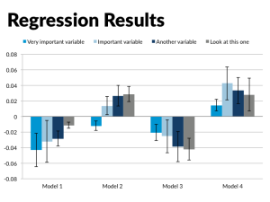
Regression results
Source: https://policyviz.com/2018/03/08/visualizing-statistically-significant-results/
Notes:
Another example using bars to indicate the values of the regression estimates
First one uses asterisks to indicate statistical significance, second one uses error bars
Source: https://policyviz.com/2015/10/07/presenting-technical-data-do-it-in-viewer-friendly-ways/

Slide 39
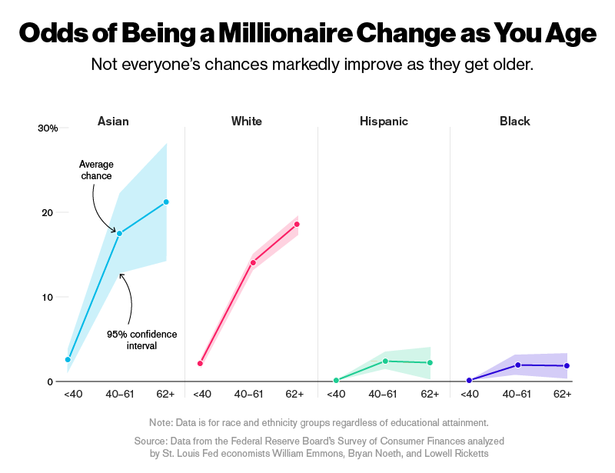
Regression results
Source: https://www.bloomberg.com/features/2016-millionaire-odds/
Notes:
Source: https://www.bloomberg.com/features/2016-millionaire-odds/

Slide 40
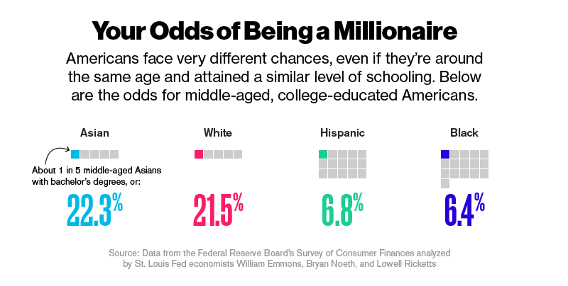
Regression results
Source: https://www.bloomberg.com/features/2016-millionaire-odds/
Notes:
St. Louis Federal Reserve Bank researchers calculated the weighted percentage of families with more than $1 million in net worth using a technique called repeated-imputation inference.
Worked with Bloomberg news to present results in a way that is easier to interpret using waffle charts
Source: https://www.bloomberg.com/features/2016-millionaire-odds/

Slide 41
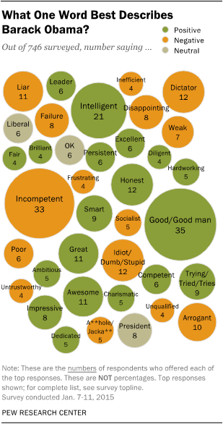
qualitative Analyses
Source: https://depictdatastudio.com/how-to-visualize-qualitative-data/
Notes:
Another example from the Pew Research Center, in which they visualized one-word descriptions of Barack Obama with packed bubbles.
Packed bubbles are similar to word clouds. In word clouds, word frequency is depicted through font size. In packed bubbles, word frequency is depicted through bubble size.
Also use color to differentiate between positive, negative, and neutral words.
Source: https://depictdatastudio.com/how-to-visualize-qualitative-data/

Slide 42
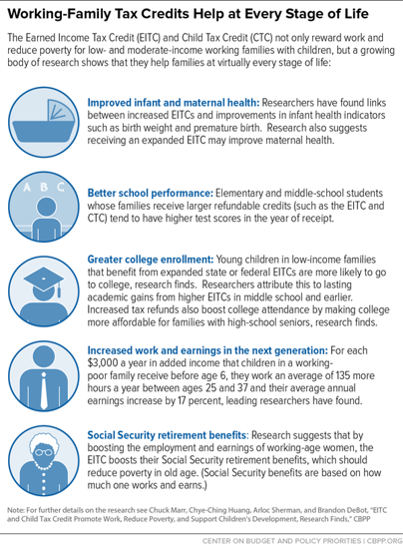
qualitative Analyses
Source: https://depictdatastudio.com/how-to-visualize-qualitative-data/
Notes:
Include Icons Beside Descriptions and Responses
Helps to break up long sections of text
The Center on Budget and Policy Priorities used icons to visualize how working-family tax credits can help at every stage of life:
Source: https://depictdatastudio.com/how-to-visualize-qualitative-data/

Slide 43
qualitative Analyses
Henderson, S., & Segal, E. H. (2013). Visualizing qualitative data in evaluation research. In T. Azzam & S. Evergreen (Eds.), Data visualization, part 1. New Directions for Evaluation,139, 53–71.
.

Slide 44
Demonstration in Excel
Agenda:
Introduction to data visualization
5 principles for better visualizations
How to utilize different types of visualizations
Demonstration in Excel
Resources for learning more about data visualization

Slide 45
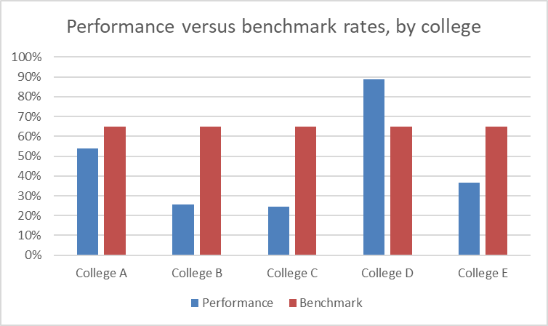
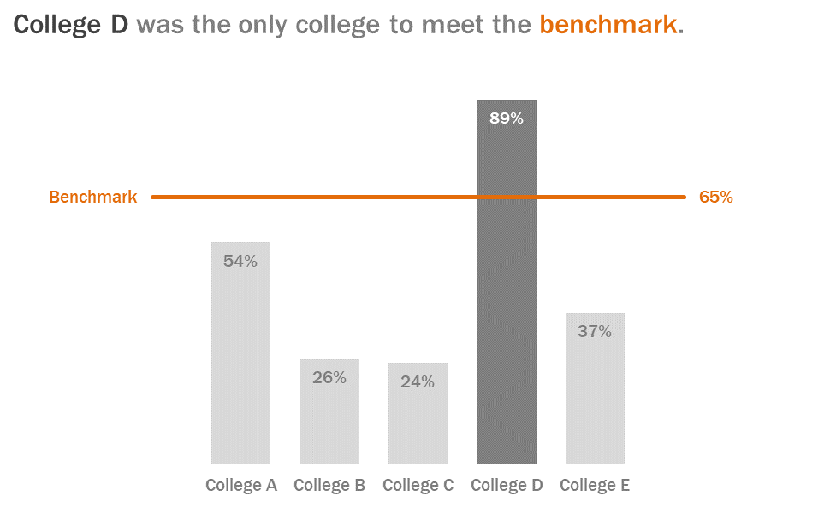
Excel Demonstration

Slide 46
Move from Data to Action
Duarte, N. (2019). DataStory: Explain data and inspire action through story. IdeaPress Publishing.
Notes:
Making a recommendation requires that you first judge the data: This chart went up. Was that good? Was it expected? Should we keep going in this direction, or change course? Do we have all the data we need to make a good decision? (p. 20)
If we’re college D – yes, that’s good. We should probably keep going in this direction
If we’re college A, we probably need for information. Even though we’re not meeting the benchmark, are we improving over time and getting closer to the goal?
“Making good recommendations from data requires a combination of data analysis and intuition, along with a degree of imagination and argumentation. Making a good recommendation involves more than presenting data that proves – or disproves – your hypothesis. That’s just a starting point. A recommendation then takes the creative steps of proposing which action should be taken, and a good one makes a persuasive case for that action.”
Maybe there’s something College D is doing that we can replicate to improve our performance
Maybe this isn’t a fair comparison – the composition of students may differ. Maybe we should talk about strategies for helping the lowest performing students
Many of you work in the same institution you are studying – you bring unique insights

Slide 47
Resources for learning more about data visualization
Agenda:
Introduction to data visualization
5 principles for better visualizations
How to utilize different types of visualizations
Demonstration in Excel
Resources for learning more about data visualization

Slide 48

Resources for Data visualization
Summer elective – EDH 5645

Slide 49
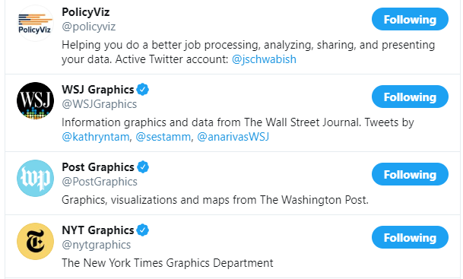
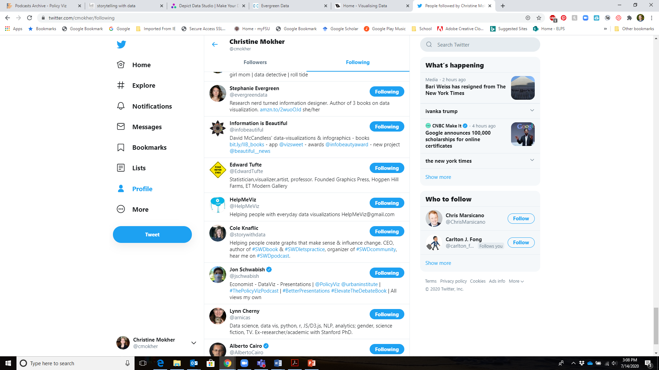
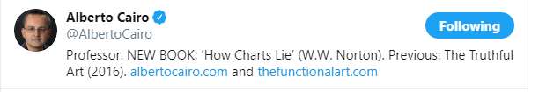
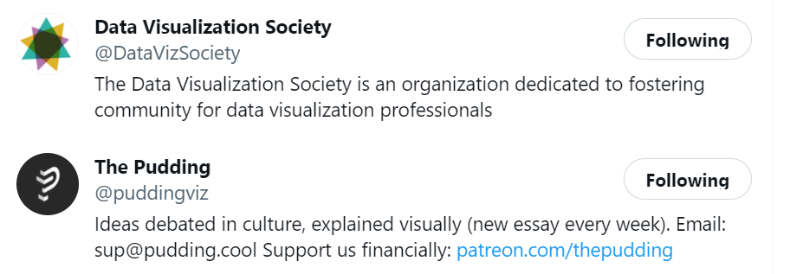
Resources for Data visualization

Slide 50
Resources for Data visualization
Blogs and podcasts:
PolicyViz – https://policyviz.com/
Storytelling with data - http://www.storytellingwithdata.com/
Depict Data Studio - https://depictdatastudio.com/
Evergreen Data - https://stephanieevergreen.com/
Visualizing Data - https://www.visualisingdata.com/
EagerEyes - https://eagereyes.org/
Flowing Data - https://flowingdata.com/
Tableau Zen Masters - https://www.flerlagetwins.com/
Online publications:
Nightingale: https://nightingaledvs.com/
The Pudding: https://pudding.cool/

Slide 51
Resources for Data visualization
Books:
Berinato, S. (2016). Good charts: The HBR guide to making smarter, more persuasive data visualizations. Harvard Business Review Press.
Cairo, A. (2012). The Functional Art: An introduction to information graphics and visualization. New Riders.
Cairo, A. (2016). The truthful art: Data, charts, and maps for communication. New Riders.
Camões, J. (2016). Data at work: Best practices for creating effective charts and information graphics in Microsoft Excel. New Riders.
Evergreen, S. D. (2019). Effective data visualization: The right chart for the right data. Sage Publications.
Few, S. (2009). Now you see it: simple visualization techniques for quantitative analysis. Analytics Press.
Kirk, A. (2016). Data visualisation: A handbook for data driven design. Sage.
Knaflic, C. N. (2015). Storytelling with data: A data visualization guide for business professionals. John Wiley & Sons.
Schwabish, J. (2020). Better data visualizations: A guide for scholars, researchers, and wonks. Columbia University Press.
Schwabish, J. (2016). Better presentations: A guide for scholars, researchers, and wonks. Columbia University Press.
Tufte, E. R. (2001). The visual display of quantitative information (Vol. 2). Cheshire, CT: Graphics press.
Yau, N. (2011). Visualize this: the FlowingData guide to design, visualization, and statistics. John Wiley & Sons.

Slide 52
Questions?
Christine Mokher, Ph.D.
cmokher@fsu.edu

